Slide 1
Texture Density Adaptation and the Perceived Numerosity and Distribution of Texture
Frank H. Durgin (1995)
Hunjae Lee, VCC Lab
2009-11-11

Slide 2
Introduction
When we see the complex texture
- Detail is lost, abstract summary lefts, then what is it?
What do we see when we look at scatter-dot texture?
Numerosity (number of dots)
Cluster (from texture density)

Slide 3
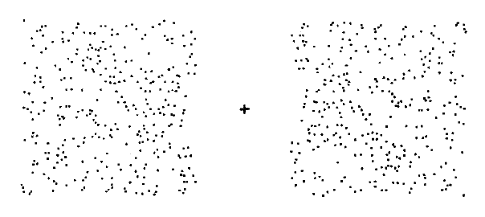
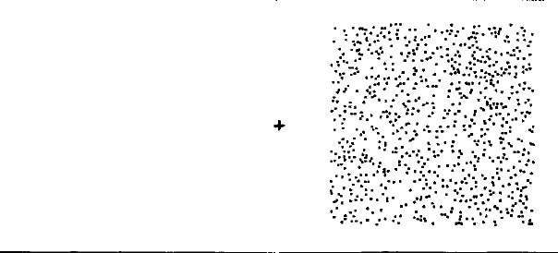
Basic Procedure (Visual after effects)
Demo

Slide 4
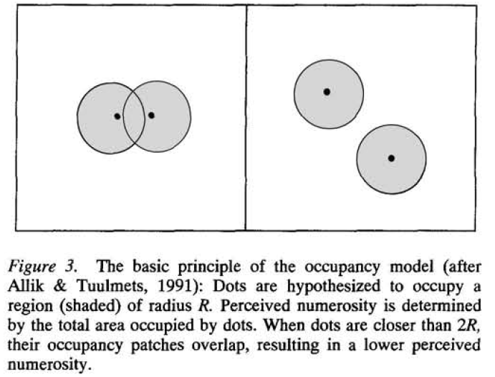
Reviews and Prediction
Occupancy Model (Allik & Tuulmets, 1991)
Numerosity and Density (Barlow, 1978)
Prediction
High density -> Affect on perceived numerosity Not much on the cluster
Low density -> Slight distortion at numerosity Large change in cluster
R

Slide 5
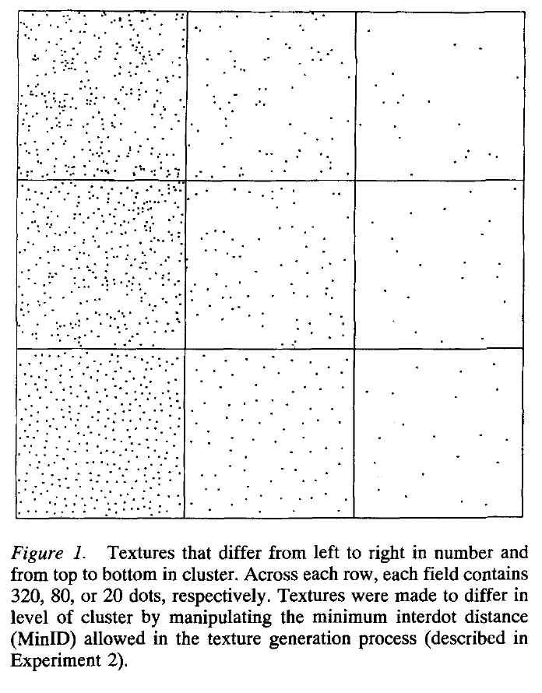

Slide 6
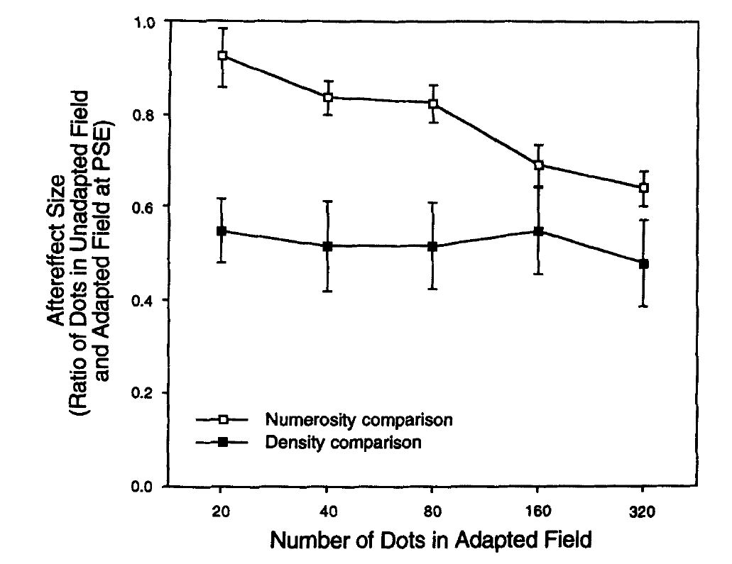
Experiment 1 and Results

Slide 7
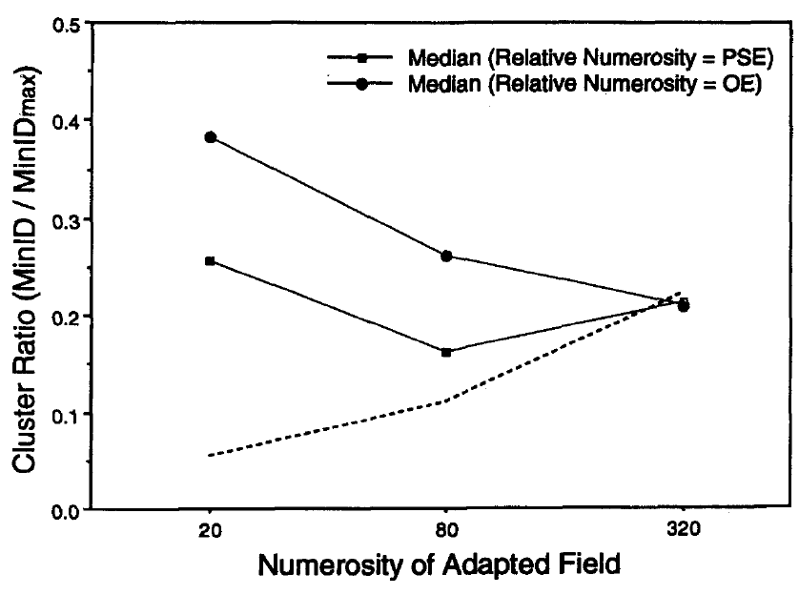
Experiment 2 And Results

Slide 8
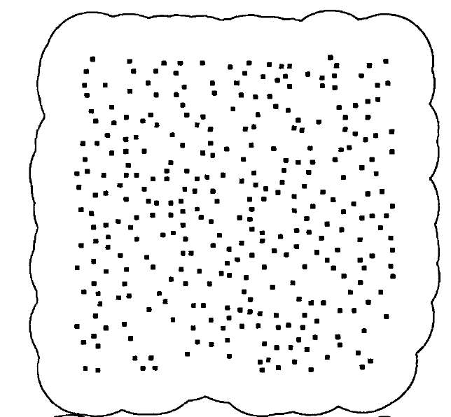
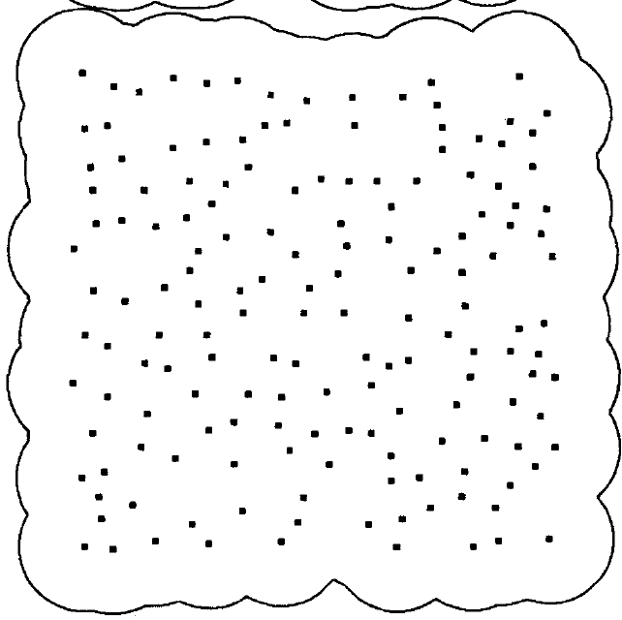
Problem of Occupancy Model

Slide 9
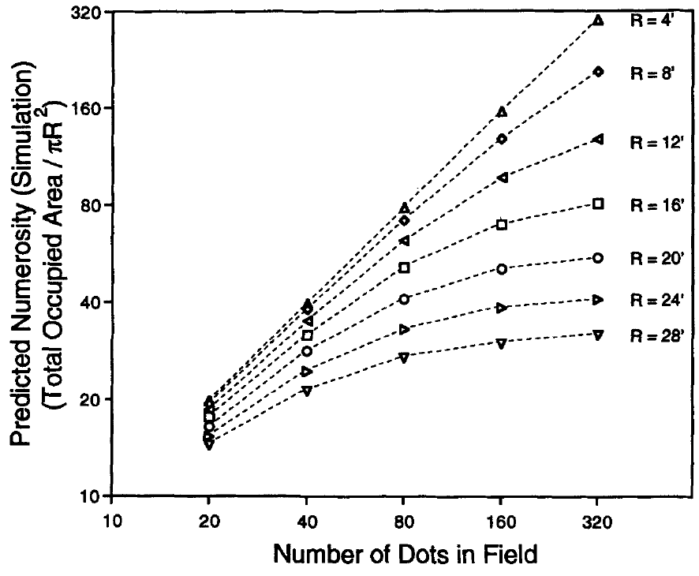
Simulation of Occupancy model

Slide 10
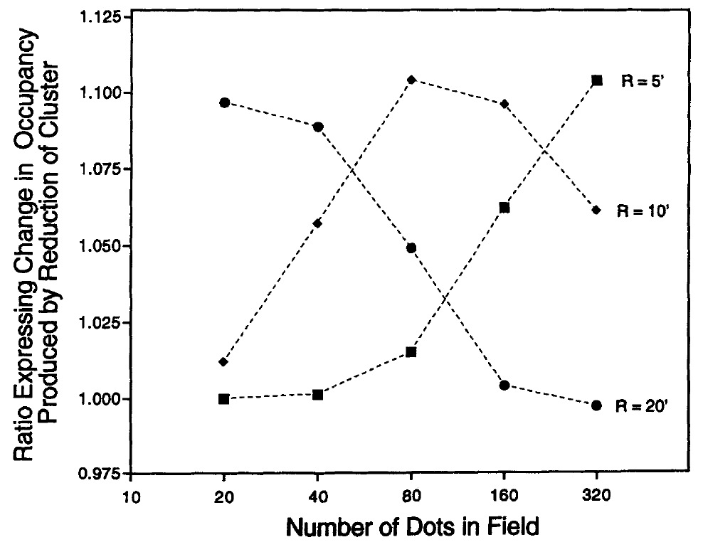
Simulation of Occupancy model

Slide 11
Conclusion and Discussion
The effects of adaptation on numerosity and clustering judgments appear to be range dependent and reciprocal.
In Occupancy model, R must vary with texture density, (density information must be presupposed by the model)
Why does the system not use the smallest R?
- for numerosity , for cluster…

Slide 12
Numerical Cognition :Reading Numbers from the Brain
Roi Cohen Kadosh and Vincent Walsh
13, October (2009)

Slide 13
They sum up Eger et al (2009)
Eger et al (2009). Deciphering Cortical Number Coding from Human Brain Activity Patterns.
Wrap up and some opinions

Slide 14
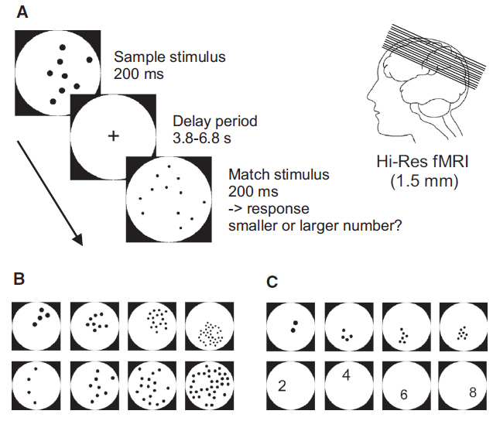
Overview of Experimental Design

Slide 15
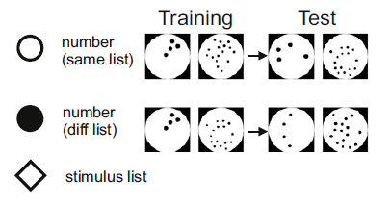
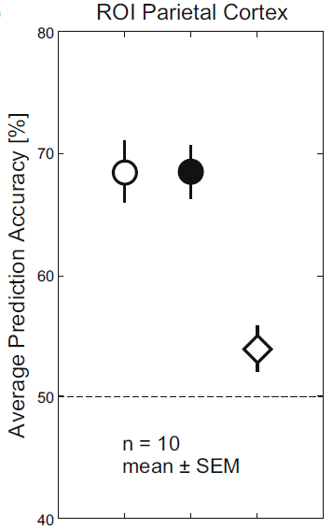
Summary

Slide 16
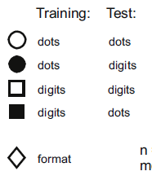
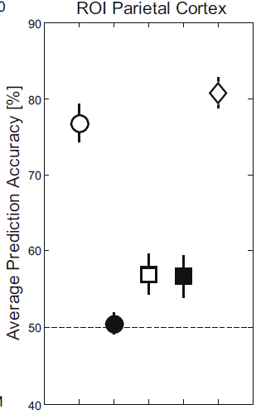
Summary

Slide 17
Discussion
So, Durgin on the corner?
Oakyoon, What was the problem of this experiment (you mentioned at lab meeting, 21st Oct)
Any idea about number, number, magnitude…

Slide 18
Thank you
Again, please say something ! ☺

