Slide 1
The Relationship between Saccadic Suppression and Perceptual Stability
Tamara L. Watson and Bart Krekelberg (2009)
Hunjae Lee, VCC Lab
2009-10-28

Slide 2
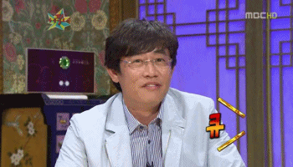
Introduction
Background - Saccade - Perceptual stability - Saccadic omission - Saccadic suppression - Shape-contrast illusion
Goal
Conclusion

Slide 3
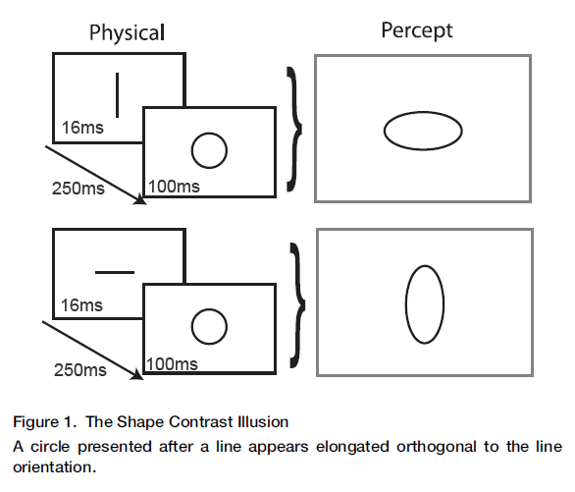
Experimental Procedures
A shape-contrast effect for briefly presented stimuli (Suzuki & Cavanagh, 1998)

Slide 6
Experimental Procedures
Experiment 1 - Testing the basic shape contrast illusion. - Center of the screen - 2 (horizontal or vertical line) * 2 (present or absent) * 2 (horizontal or vertical elongation) * 5 (10%, 7.5%, 5%, 2.5%) * 16 (Iteration)
- Reporting the shape of the ellipse.
- %PHE (peceived horizontal elongation)
- The threshold at 50% was considered the point of subjective circularity

Slide 7
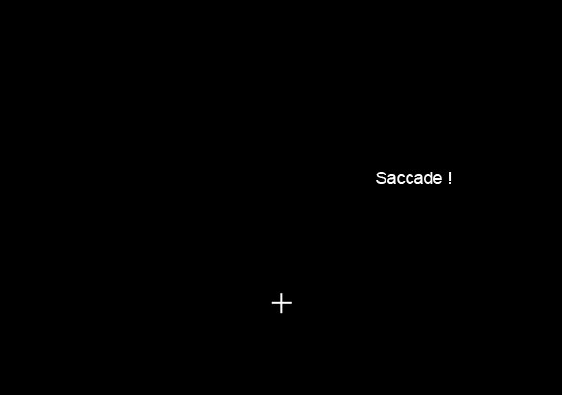
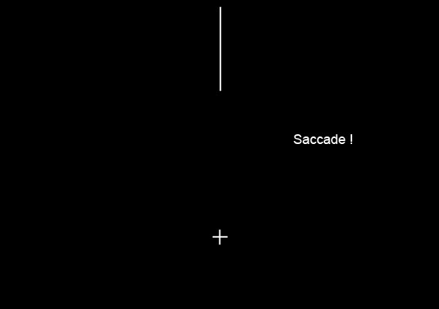
Experimental Procedures
Experiment 2

Slide 8
Experimental Procedures
Task - Reporting presence of inducer line - Reporting the shape of the ellipse.

Slide 9
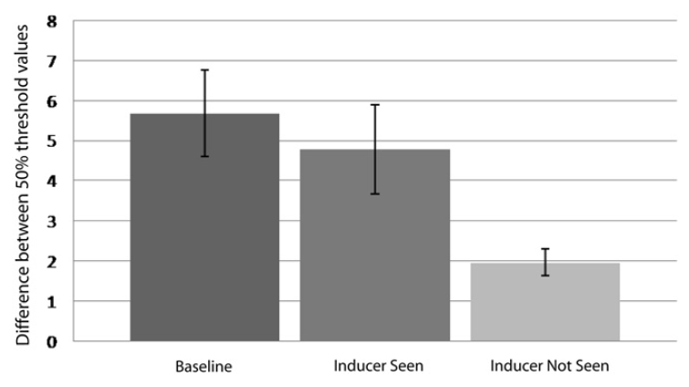
Results

Slide 10
Visual Perception: Saccadic Omission – Suppression or Temporal Masking?
Michel R. Ibbotson and Shaun L. Cloherty (2009)

Slide 11
Suppression or Temporal Masking ?
Stepping forward from Watson et al (2009)
Mechanism of omission
- Suppression of the visual pathways (Burr et al)
- Backward temporal masking (Wurtz et al)

Slide 12
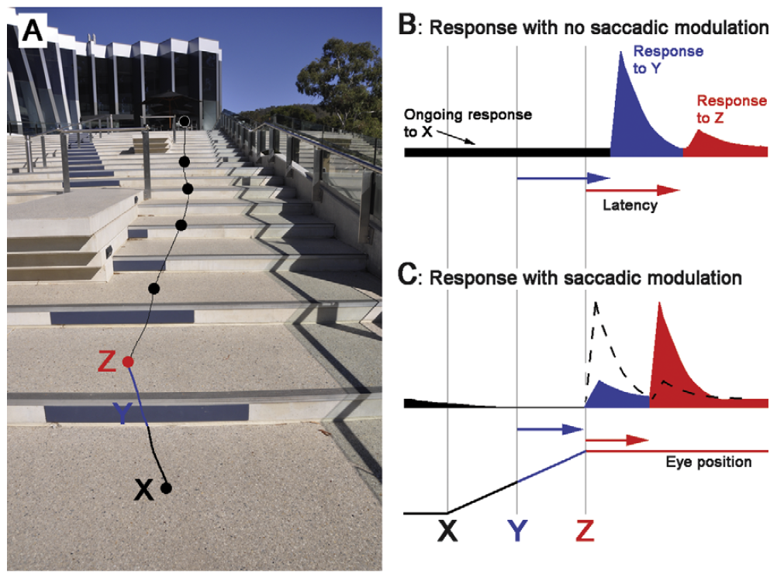

Slide 13
Unifying theory
Modulation - Pre-saccadic reduction & Post-saccadic enhancement.
- The latencies of responses to post-saccadic stimuli are reduced.

Slide 14
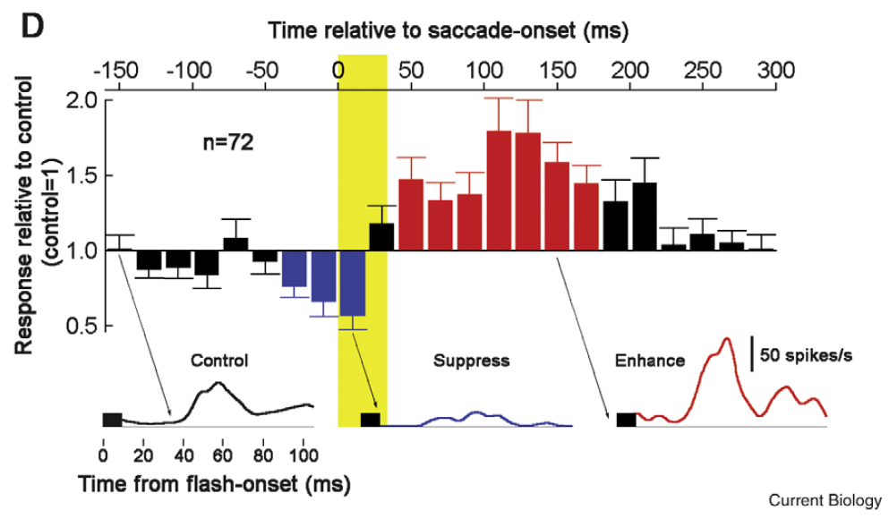

Slide 15
Discussion
Early versus Late
Retinal versus Extraretinal (Masking versus Suppression)
Dorsal versus Ventral
Purpose of saccadic suppression ? - Perisaccadic signals are useful?
Then, what is suppressed during saccade?

Slide 16
Thank you
Please say something ! ☺

